Slide 1

THIS IS NOT SCHOOL.
THIS IS DSI.

Slide 2
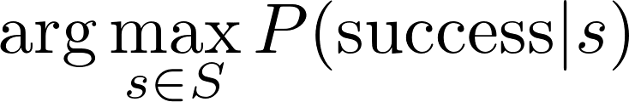
What is your best strategy?
Want to know the answer?
Stay tuned...
Notes:
We’re putting this in terms you’ll understand. :)
\arg\max_{s \in S} P(\text{success} | s)

Slide 3
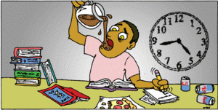
Your worst strategy:
Daily Strategy (a prioritized list):
Stress that you won’t finish today’s assignment. Worry that you’ll get behind.
Try to catch up on yesterday’s assignment. Worry that you are behind.
Sleep a few hours.
Wake up having very little mental energy for tomorrow.

Slide 4
Your best strategy:
1. SET THE STAGE
(prepare your brain)
2. PLAY
(wrestle with it & have fun)
3. REFLECT
(remember your “why”)
Notes:
This is language from Pira’s talk.

Slide 5
Your best strategy:
Daily Strategy (a prioritized list):
Take care of yourself (~12 hours/day)
Eat, Sleep, Exercise
Prepare for tomorrow (~2 hours/day)
Do the reading the night BEFORE.
Let your brain chew on it while you sleep.
Soak up as much as you can of today’s topic (~10 hours/day)
YOU WILL NOT SOAK IT ALL UP. Do what you can, then find a good logical stopping point.
Obeying #1 and #2 will maximize the amount you soak up.
3-month Strategy:
Perform the daily strategy EVERY DAY.
One day a week don’t do DSI work at all.
“Catch up” during the break week (between week 6 & 7).
Pick a project that interests you.
“Catch up” while working on your project:
Your project will use at most 20% of the topics we’ve covered.
You can catch up on that 20% while doing your project.
Practice interviewing, and practice pitching your project.
Speak with confidence, sell yourself, and land a job.
Notes:
This is the opinion of the whole instructional staff. This isn’t our first rodeo, trust the system.

Slide 6
NOW
Get to work.

